Slide 1
Apriori Algorithm

Slide 2
Purpose/Use
An itemset is a set of two or more items.
In data mining, frequent itemset mining is a technique used to items which often occur together.
Based on this we can create association rules which help us to understand how items are associated with each other.
Apriori algorithm is an algorithm which uses bottom-up approach for association rules analysis.

Slide 3
Purpose/Use
Learning of association rules is used to find relationships between attributes in large databases.
It is commonly used for Market Basket Analysis - to study purchashing patterns of customers.
This analysis is beneficial for increasing sales, maintaining inventory, shelf management ( proper placing of items in the shelves) for maximum efficiency andprofit.

Slide 4
Measures related to items
support(X) = no. of transactions in which X appears
total no. of transactions
confidence (X --> Y) = supp (X U Y)
supp (X)
lift (X --> Y) = supp (X U Y)
supp (X)* supp(Y)
conviction(X --> Y) = 1 - supp(Y)
1 - conf(X --> Y)
where X,Y are items

Slide 5
Drawbacks
This algorithm scans the transactions for each iteration.
Candidate generation is a bottleneck.
The process is slow and the runtime increases exponentially with increase in number of itemsets.

Slide 6
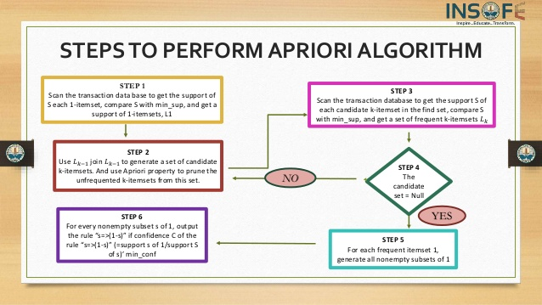

Slide 7
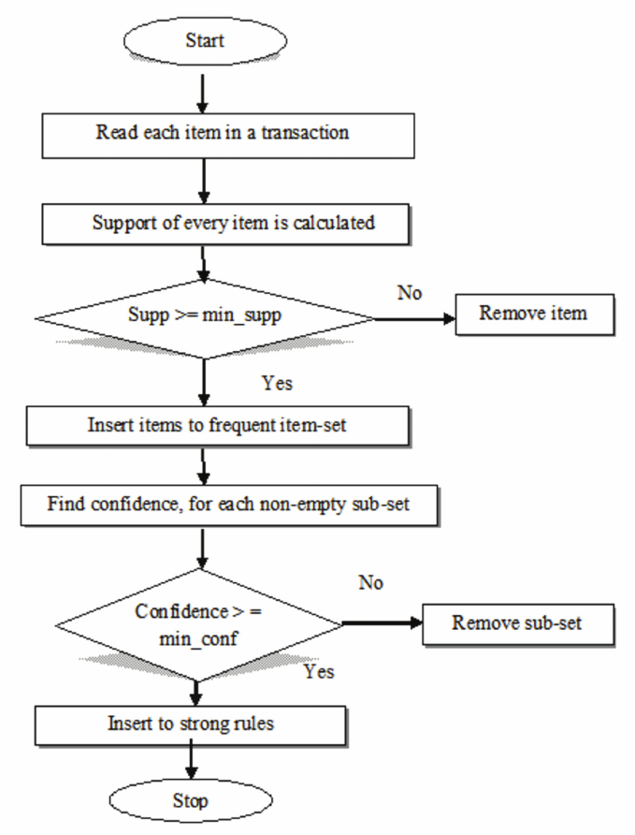
Flowchart

Slide 8
Apriori Properties
1. All subsets of a frequent itemset must be frequent.
2. Similarly, for any infrequent itemset, all its supersets must be infrequent,too.

